Slide 1


Department of Public Safety
Emergency Communication Networks
Presenter: T. John Cunningham, Fire Chief, City of Elk River
Notes:
What is FirstNet?

Slide 2
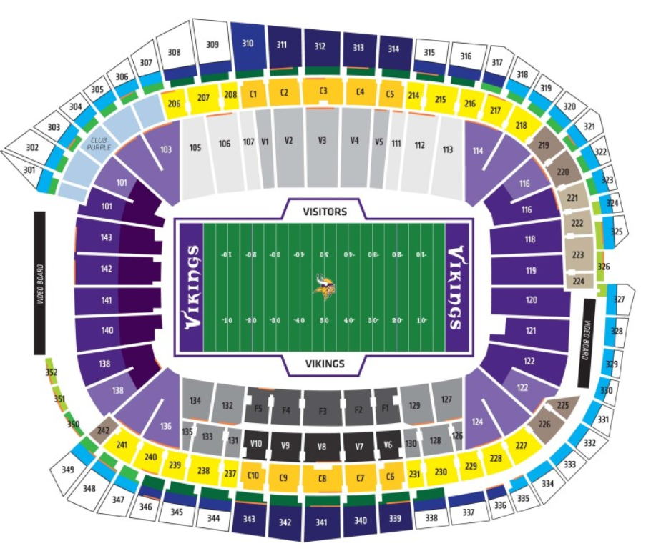
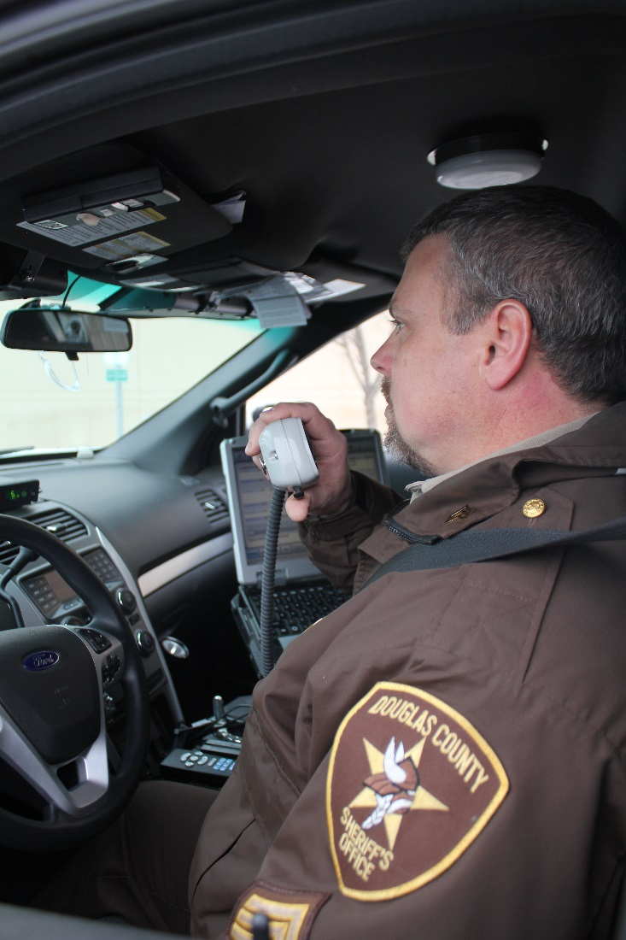
What is FirstNet?
Dedicated Network
Notes:
What would Public Safety do with a dedicated network?
Hmm . . .
No longer compete with the public for bandwidth… that is what we have today with commercial carriers.
More intensive GPS usage,
Streaming video
Overall a Better User Experience, actually get useful data you can use in the field when you need it.
How about being aware of your staff at a planned event like a Vikings Game?
Did anyone with an arrest warrant show up for the game today while we were running the facial recognition software at the entrances?
That streaming video you got from Gate H shows a missing child, and you at Gate A see that child near you, no worries, the child is returned to Mom & Dad in record time. Those are Happy Fans!

Slide 3


Source: NBC Facebook page
Notes:
Are you questioning whether public safety needs its own network? After all the iPhone you have today is running all those applications that we hear about. Active 911, I Am Responding, CJIS connections, VPN, email, the list goes on . . .
Cellphone usage has exponentially grown in the last several years. Compare the crowds from 2005 to 2013. I see one flip phone in the 2005 photo near the bottom right. In 2013 mobile devices are all over.
Commercial entities (Verizon/ATT) (1) are not prioritized for public safety. The networks are not Public Safety Grade, and will crash if flooded with too many users accessing the network.
Federal mandate from the legislation inacting FirstNet states that quality of service, priority, pre-emption, rural coverage, ruggedized equipment, a device and application ecosystem which includes a Bring Your Own Device Plan, all need to be a part of this network.

Slide 4
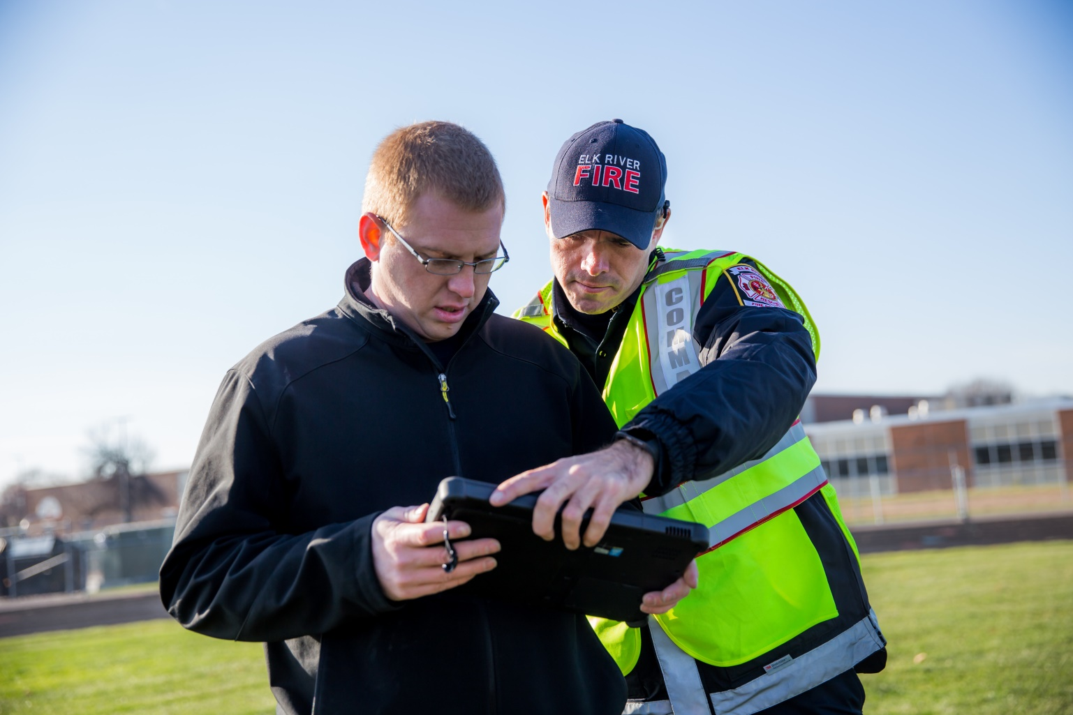
Minnesota
Elk River Public Safety Broadband Pilot

Slide 5

What is FirstNet?
Looking for FirstNet Partner
Notes:
This dedicated network is coming, and FirstNet is looking for a partner.
FirstNet intends to present a state plan in the second quarter of 2017, although MN can opt to reject that plan and build it’s own network.
ECN is conducting its due-diligence to have a plan that meets MN’s needs based on the research that has been conducted over the last few years.
FirstNet has the same commitment to bring the best state plan to all the states and territories.

Slide 6
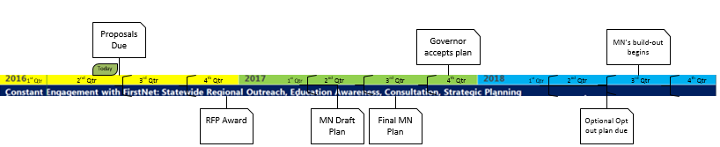
What is FirstNet?
FirstNet’s Projected Timeline
2020 – Half way
2022 – Objectives Met
Notes:
The RFP was released on Jan 13, 2016.
Proposals are due on May 31.
FirstNet’s goal is to award a contract by the end of this year.
They will present a state plan for deployment with a pricing schedule, in the second quarter of 2017 using a web portal that will be accessible by the public.
Towards the end of that quarter the Governor can accept the plan, or MN can start building its own broadband network provided that plan is approved at the federal level. It will still need to be interoperable with all broadband networks in the rest of the states and territories.
At the 24-month point after the build-out begins, the plan should be at a 50% implementation stage, approximately mid 2020.
At the 48-month stage, 2022, FirstNet can start implementing penalties if the Partner doesn’t achieve the goals established in the state plan.

Slide 7


What is FirstNet?
Cost?
Notes:
What is it going to cost? It is always about the bottom line.
If the Governor decides to accept the FirstNet plan:
There is no cost to the State for network deployment.
There is no cost for operation and upgrades of the FirstNet Network.
Monthly user fees and devices would be funded by subscribers and/or agencies as they are now for commercial networks. There may be some costs for interfaces between Agency data, and FirstNet data.
FirstNet will need to be competitive. They still need to win your business.
Individual agencies still have the option to use commercial carriers or the FirstNet network.

Slide 8
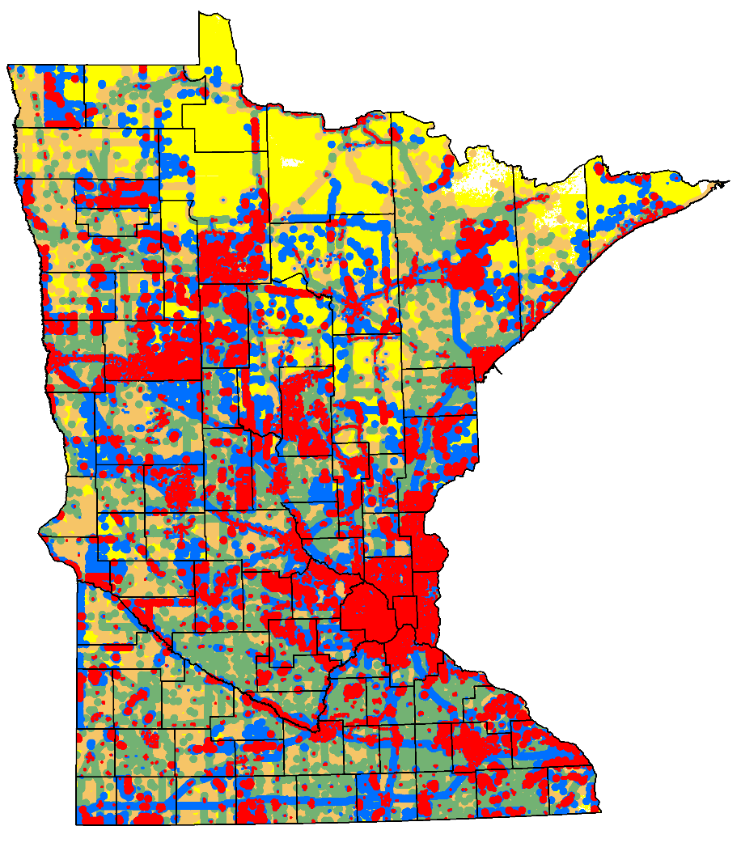
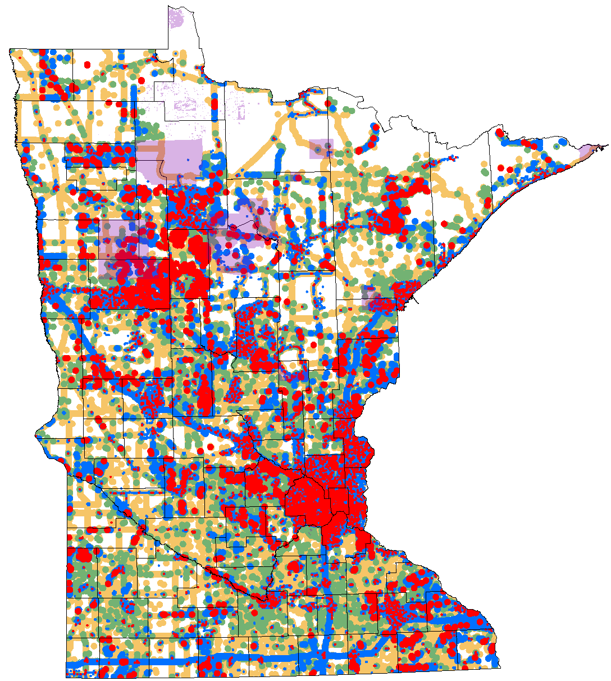
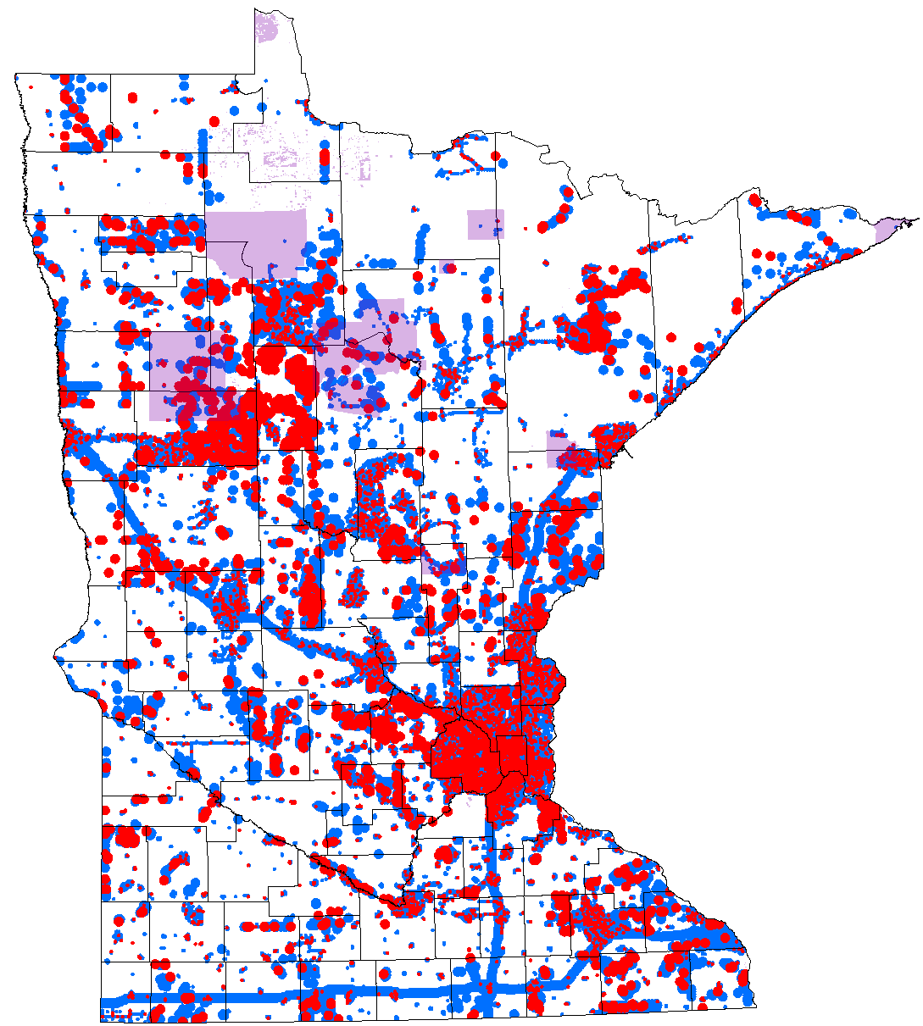
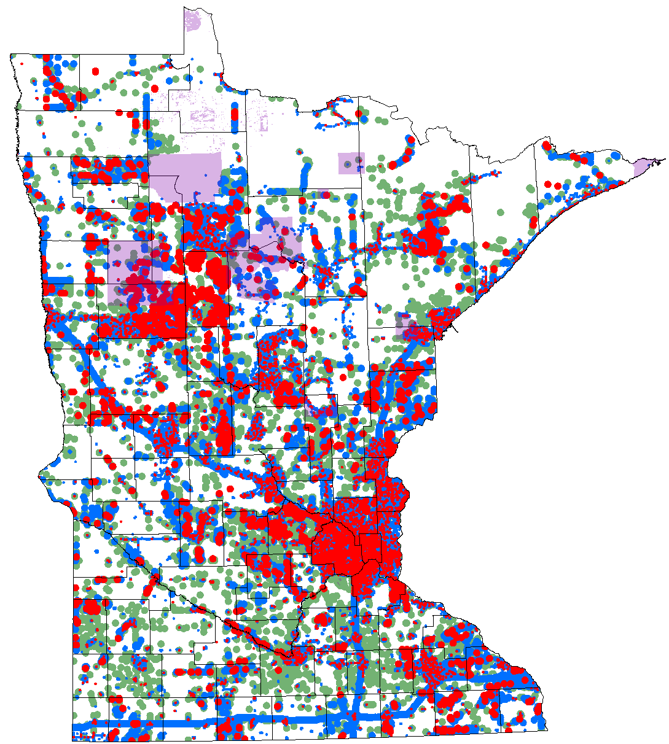
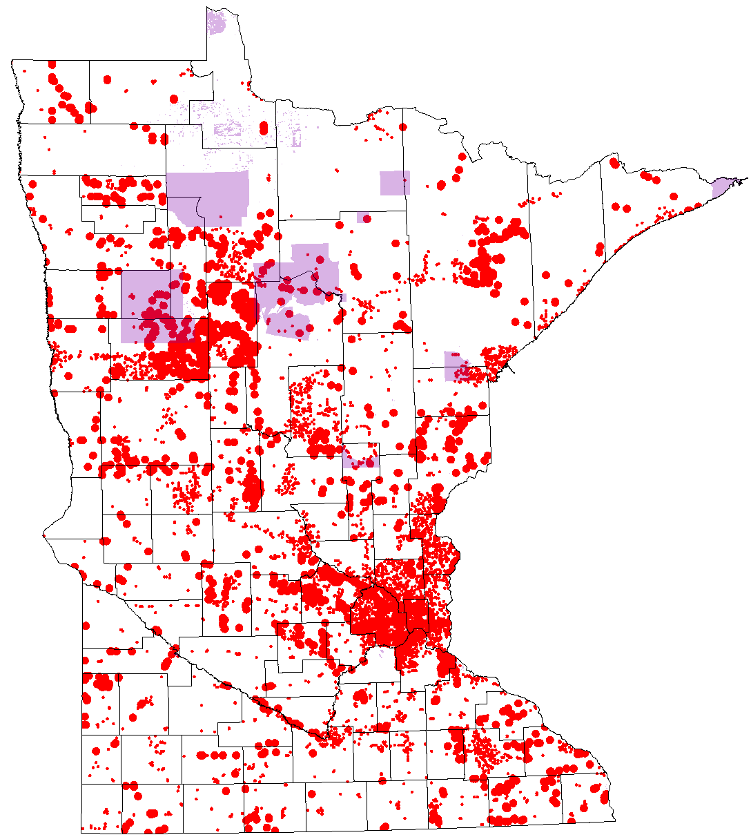
Phased Buildout
** 95% coverage per county requested by the SECB of FirstNet
Notes:
FirstNet has requirements to meet rural coverage objectives.
They intend to continually improve the network for coverage, and capacity.
They must continually update the technology to meet the latest standards in the industry.
They are required to reinvest any profits over expenses to make continuous improvements over the life of the contract.
The intent is to have coverage everywhere from International Falls to the Iowa Border.

Slide 9
Resources
Minnesota FirstNet Consultation Project (MnFCP)
https://dps.mn.gov/divisions/ecn/Pages/broadband.aspx
FirstNet
http://firstnet.gov/
OhioFirst.Net
Visualize the life-saving potential of public safety grade high-speed data and 3D positioning to enhance your situational awareness when time matters most.
Notes:
Thank you for listening, and contributing to the research.
I think this network will provide good opportunities to improve and innovate solutions for Public Safety in MN.

Slide 10
Questions?
Jackie Mines, MN DPS-ECN
Jackie.Mines@state.mn.us
(651) 201-7550
Melinda Miller, MN DPS-ECN
Melinda.Miller@state.mn.us
(651) 201-7554
Randy Donahue, Southern RIC
Randy.Donahue@state.mn.us
(507) 360-2660
Rick Juth, Central & Metro RIC
Rick.Juth@state.mn.us
(612) 743-0252
Marcus Bruning, Northern RIC
Marcus.Bruning@state.mn.us
(218) 232-3762
T. John Cunningham, Fire Chief, City of Elk River
jcunningham@ElkRiverMN.gov
(763) 635-1105
Notes:
Thank you for listening, and contributing to the research.
I think this network will provide good opportunities to improve and innovate solutions for Public Safety in MN.

