Slide 1
COVID – 19 Checklist 3-14-2020

Slide 2
3_14_2020 Note: Subject to change based on current recommendations
Response Checklist - COVID-19
All EMS Responses - Medium Precautions - Level II
1. PPE – minimum for all providers:
Gloves & Standard Eye Protection & N-95.
After call, if patient determined to be effectively no risk for COVID-19, N-95 respirator may be stored in paper bag for
later use (keep for no longer than 8 hours).
2. Door Triage/room scan/6 ft of separation:
Does anyone have fever, cough, respiratory distress? YES- Level III PPE
Dispatch positive screen for PPE? YES-follow instructions 3 and 4 below:
3. Treatment Precautions:
Providers should have a low threshold for upgrading to Goggles/Face Shield
If safe/feasible, consider having the patient brought to the entry point of the building.
Minimize providers in the building required for patient care.
Surgical mask for the patient, nasal cannula can be used under a surgical mask.
A surgical mask can be placed over a non-rebreather mask.
NO ORAL TEMPERATURES
4. Transport Precautions:
Driver will remove eye protection/gloves. Minimize providers in the back of unit.
CDC guidance for ventilation during transport, see “Transporting Instructions.”
Assisted care, adult family home, nursing home, clinic, jail, other high-risk facility = Level III PPE
High Precautions - Level III
1. Does anyone have a fever, or cough, or respiratory distress?
2. Is the Patient or Facility suspected to have COVID-19?
3. Had previous contact with a COVID-19 patient?
4. Is patient from a high-risk facility (Assisted Care, AFH, Nursing home, clinic, jail)?
5. May require aerosol-generating procedures?
If Yes to any question = High Precaution Level III PPE If No to all questions = Level II PPE
PPE- gloves, N-95, goggles or face shield, and gown. Surgical mask on patient.
Follow all Instructions in Level II
Contact the MSO for support as needed.
Contact destination hospital and advise you have an isolation patient.
Precautions for Aerosol Generating Procedures
If patient condition REQUIRES use of invasive airway interventions:
Level III PPE required during all aerosol generating procedures:
BVM, Suctioning, CPAP, iGel, Intubation, Nebulized meds, NRB (if no surgical mask).
Nebulized meds used as a last resort-consider other appropriate treatments first.
BVMs should be equipped with HEPA filters.
Use Supraglottic airway (SGA) instead of intubation for suspected/known COVID-19 patients.
Intubation allowed if SGA will not oxygenate and ventilate.
DO NOT USE VENTILATORS
Maximize area ventilation during these procedures-open doors, use exhaust fans.
Contact Medical Control as needed for guidance.

Slide 3
3_14_2020 Note: Subject to change based on current recommendations
Transporting Instructions
Family members and contacts of patients with possible COVID-19 should not ride in the transport vehicle.
Isolate the ambulance driver from the patient compartment.
During transport, vehicle ventilation in both compartments should be on non-recirculated mode to maximize air changes that reduce potentially infectious particles in the vehicle. If the vehicle has a rear exhaust fan, use it to draw air away from the cab, toward the patient-care area, and out the back end of the vehicle.
Open the outside air vents in the driver area and turn on the ventilation fans to the highest setting.
Decontamination Checklist
Daily - Deep cleaning of stations and apparatus will be conducted after each run for service when coming in contact with patient.
ALL PRIMARY DECON TO BE DONE BEFORE ENTERING STATION. DO NOT CONTAMINATE STATION.
PPE Use - N-95 Masks & Gowns = single use Eye Protection and Goggles = decontaminate and reuse.
Level II – Properly dispose of PPE. Wash hands. Deep clean apparatus.
Level III – EMS Transport units Will Perform Decontamination at hospital:
Properly dispose of PPE. Wash hands. Deep clean apparatus. Disinfect goggles then wash with soap/water. Launder uniforms as appropriate per agency infection control guidelines
If any aerosol generating procedures were performed on a COVID-19 SUSPICIOUS PATIENT (symptoms or possible contact with COVID pt) or any time providers feel that higher level decon is warranted:
1. After patient transfer, properly dispose of PPE and wash hands.
2. Deep clean apparatus wearing PPE (see guidelines below). Decon boots with Simple Green.
3. Outside rig or in hospital Decon room, doff and bag personal clothing, don Tyvek suit.
4. Place bagged personal clothing in exterior compartment.
5. Return to station. Launder personal clothing wearing PPE.
6. Shower and don fresh clothing.
Note: Crew members involved in aerosol generating procedures who do not transport:
See decon guidance on page 3
Cleaning EMS Transport Unit after Transporting a Patient with Suspected/Confirmed COVID-19
Allow for maximum ventilation in patient compartment by keeping all doors open while delivering patient.
PPE for EMS Rig Decon: gown and gloves minimum. Googles and mask if splashes or sprays anticipated.
Routine cleaning and disinfection procedures (e.g. using cleaners and water to pre-clean surfaces prior to applying disinfectant) are appropriate for SARS-CoV-2 (COVID-19). Pre-cleaning removes gross contaminants prior to disinfection.
Follow directions on Simple Green bottle for thorough disinfection.
Clean and disinfect all surfaces that patient may have contacted and all surfaces that may have been contaminated by aerosol generation.
Clean and disinfect all reusable patient-care equipment before use on another patient.

Slide 4
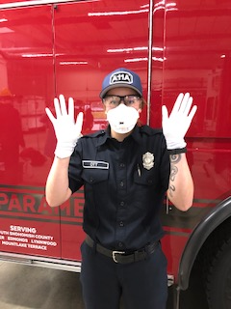
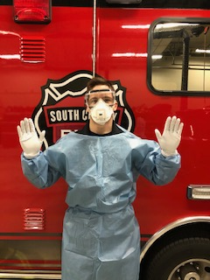
PPE Precautions – Levels I, II, III
3_14_2020 Note: Subject to change based on current recommendations
Level I / Standard Level II / Medium Level III / High
-Gloves
-N-95
-Eye Pro or Goggles
-Gloves
-N-95
-Goggles/Face Shield
-Gown / Tyvek Suit
Donning PPE Sequence: MEGG
Mask
Eyes
Gown
Gloves
To Doff PPE, just reverse the donning sequence: GGEM
Gloves
Gown / Tyvek Suit - Wash Hands
Eyes
Mask- Wash Hands
Decon guidance for non-transport crews when aerosol generating procedures were performed on COVID-19 SUSPICIOUS PATIENT
AT SCENE:
Doff and bag all PPE.
Decon boots.
Doff and bag FF Personal Clothing.
Don Tyvek suit.
Bagged FF Personal Clothing placed in exterior compartment.
Return to station.
Launder contaminated clothing wearing PPE.
Shower and don fresh clothing.
If unable to decon at scene:
Do steps 1-4 on ramp-NOT INSIDE THE BAY
Decon inside of rig wearing PPE per instructions on page 2.

Slide 5
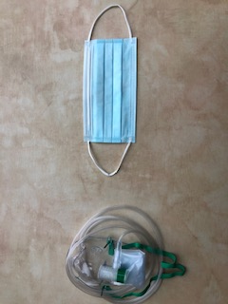
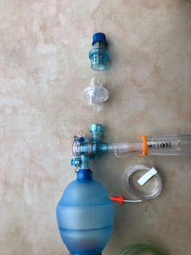
Care of the infectious patient needing oxygen or advanced airway management
3_14_2020 Note: Subject to change based on current recommendations
Nasal Cannula
Place nasal cannula
Place surgical mask over the face
Titrate oxygen flow rate from 2-6 LPM
Non-Rebreather
Place non-rebreather mask
Place surgical mask over the face on top of NRB mask
Titrate oxygen flow rate from 6-15 LPM
BVM
Place HEPA filter on exhalation port
Ensure and maintain mask seal
Titrate oxygen flow rate to patient need
I-gel
Place HEPA filter on exhalation port
Place ETCO2
Ensure I-gel is seated appropriately

